Slide 1

Handwritten digit recognition
Deep Learning (18CSE484T) Group Project 1
Bhavesh Laddagiri (RA1911026030032)
Akshaj Vishwanathan (RA1911026030003)
Hardik Gupta (RA1911026030027)

Slide 2
Contents
Dataset and Preprocessing
Model
Training and Results
Deployment

Slide 3
Building the Model

Slide 4

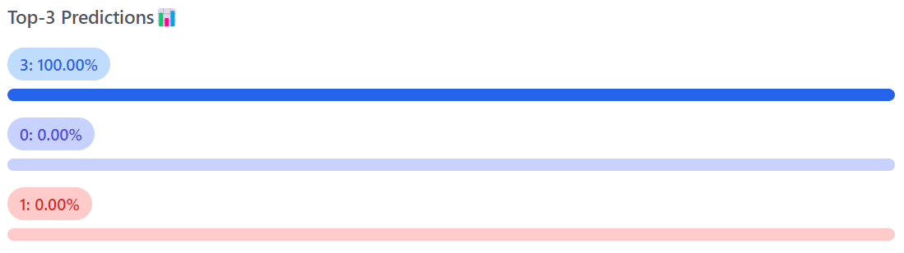
Dataset and Preprocessing
Handwritten Digit Recognition is the task of classifying digits from 0 to 9 that are drawn by hand.
The MNIST dataset is a collection of 70,000 such grayscale images of dimensions 28 x 28.
The dataset is split into 60,000 train image and 10,000 test images.
By default the dataset is already preprocessed but to account for unseen images we create a preprocessing pipeline to resize images to 28 x 28 and turn them into grayscale.

Slide 5
Model Architecture (PyTorch)
0
1
Conv 2D of 32 3x3 Kernels
ReLU
MaxPool2D of 2x2
Conv 2D of 16 3x3 Kernels
ReLU
MaxPool2D of 2x2
256 Units
2
Flattened Vector
3
4
5
(1, 28, 28)*
(32, 13, 13)
(16, 5, 5)
6
(400,)
7
8
9
*channels, width, height
2D Convolution
ReLU Activation
2D MaxPooling
Fully Connected Linear Layer

Slide 6
Training the Model
As this is a multi-class classification problem, we used a Cross Entropy Loss function for optimizing the model parameters
The Optimizer used was Adam with a learning rate of 0.00003 (5e-3)
The model was trained for a total of 3 epochs with a batch size of 96
The summary of the results is as shown below:
Metric | Test Set
Accuracy | 98%
Avg. Loss | 0.064719

Slide 7
Deploying the Model

Slide 8
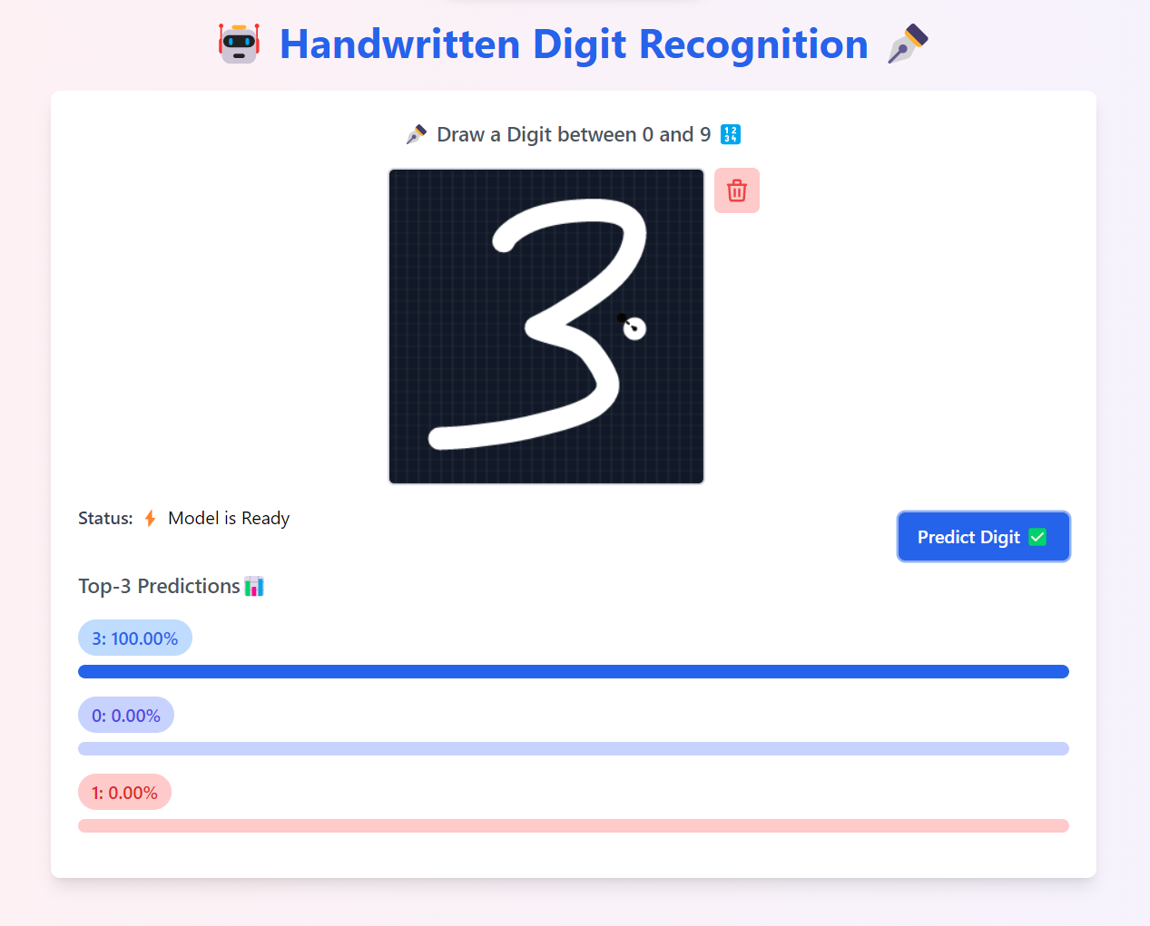
Deployment
After training the model was compiled to a torchscript graph for performant inference during deployment.
The model was first deployed as a REST API using CellStrat Hub.
A static web application was built to invoke the API for inference. Next.js (React) was used to build the application, with TailwindCSS for styling and Netlify for hosting the web app.
https://api.cellstrathub.com/gradientfire/digit
POST Request
https://digit-recog.netlify.app

Slide 9
Thank You

